Slide 1
سیستم های بلادرنگ Real Time Systems فصل سوم - مدل مرجع سیستم‌های بلادرنگ A Reference Model of Real-Time Systems
دکتر محمد حسن شيرعلی شهرضا
دانشگاه صنعتی اميرکبير

Slide 2
انواع وظیفه‌ها Types of Task
• There are various types of task
– Periodic
– Aperiodic
– Sporadic
• Different execution time patterns for the jobs in the task
• Must be modeled differently
– Differing scheduling algorithms
– Differing impact on system performance
– Differing constraints on scheduling

Slide 3
وظایف دوره‌ای یا متناوب Periodic Tasks
• Periodic Task
- a set of jobs that are executed repeatedly at regular time intervals
• Each periodic task T_{i} is a sequence of jobs J_{i,1} , J_{i,2} , …, J_{i,n}
– The phase of a task T_{i} is the release time r_{i,1} of the first job J_{i,1} in the task. It is denoted by ϕ_{i} (“phi”) – The period p_{i} of a task T_{i} is the length of time intervals between release times of two consecutive jobs – The execution time e_{i} of a task T_{i} is the maximum execution time of all jobs in the periodic task – The period and execution time of every periodic task in the system are known with reasonable accuracy at all times

Slide 4
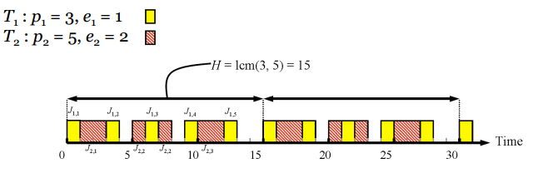
وظایف فوق دوره‌ای Hyper-Periodic Tasks
• The hyper-period of a set of periodic tasks is the least common multiple (LCM) of their periods:
– H = LCM(p_{i}) for i = 1, 2, …, n
– Time after which the pattern of job release/execution times starts to repeat, limiting analysis needed
• Example:

Slide 5
بکارگیری Utilization
• The ratio u i = e_{i} / p_{i} is the utilization of task T i
– The fraction of time a periodic task with period pi and execution time e_{i} keeps a processor busy
• The total utilization of a system is the sum of the utilizations of all
tasks in a system: U = Σ u_{i}
• We will usually assume the relative deadline for the jobs in a task
is equal to the period of the task
– It can sometimes be shorter than the period,
to allow slack time
⇒Many useful, real-world, systems fit this model; and it is easy to
reason about such periodic tasks

Slide 6
موردی و نامتناوب Sporadic and Aperiodic
• Many real-time systems are required to respond to external
events
• The jobs resulting from such events are sporadic or aperiodic
jobs
– A sporadic job has a hard deadlines
– An aperiodic job has either a soft deadline or no deadline
• The release time for sporadic or aperiodic jobs can be modeled
as a random variable with some probability distribution, A(x)
– A(x) gives the probability that the release time of the job is not later than x
• Alternatively, if discussing a stream of similar sporadic/aperiodic jobs, A(x) can be viewed as the probability distribution of their inter-release times
[Note: sometimes the terms arrival time (or inter-arrival time) are used instead of release time, due to their common use in queuing theory]

Slide 7
مدل سازی وظایف موردی و نامتناوبModelling Sporadic and Aperiodic Tasks
• A set of jobs that execute at irregular time intervals comprise a
sporadic or aperiodic task
– Each sporadic/aperiodic task is a stream
of sporadic/aperiodic jobs
• The inter-arrival times between consecutive jobs in such a task
may vary widely according to probability distribution A(x) and can
be arbitrarily small
• Similarly, the execution times of jobs are identically distributed
random variables with some probability distribution B(x)
⇒Sporadic and aperiodic tasks occur in some real-time systems, and greatly complicate modelling and reasoning

Slide 8
محدودیت‌ و وابستگی‌ اولویت ها Precedence Constraints and Dependencies
• The jobs in a task, whether periodic, aperiodic or sporadic, may be constrained to execute in a particular order
– This is known as a precedence constraint
– A job J_{i} is a predecessor of another job J_{k} (and J_{k} a successor of J_{i} ) if J_{k} cannot begin execution until the execution of Ji completes
• Denote this by saying J_{i} < J_{k}
– J_{i} is an immediate predecessor of J k if J_{i} < J_{k} and there is no other job J j such that J_{i} < J_{j} < J_{k}
– J_{i} and J_{k} are independent when neither J_{i} < J_{k} nor J_{k} < J_{i}
• A job with a precedence constraint becomes ready for execution
once when its release time has passed and when all predecessors
have completed

Slide 9
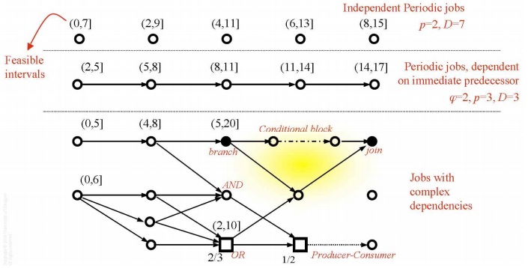
گراف وظایف Task Graphs
• Can represent the precedence constraints among jobs in a set J
using a directed graph G = (J, <)
– Each node represents a job represented; a directed edge goes from J_{i} to J_{k} if J_{i} is an immediate predecessor of J_{k}

Slide 10
گراف وظایف : محدودیت‌ها و وابستگی‌ها Task Graphs: Dependencies & Constraints
• Normally a job must wait for the completion of all immediate
predecessors; an AND constraint
– Unfilled circle in the task graph
• An OR constraint indicates that a job may begin after its release
time if only some of the immediate predecessors have completed
– Unfilled squares in the task graph
• Represent conditional branches and joins by filled in circles
• Represent a pair of producer/consumer jobs with a dotted edge
• Use to visualize structure of real time systems

Slide 11
پارامترهای عملکردی Functional Parameters
• Jobs may have priority, and in some cases may be interrupted by
a higher priority job
– A job is preemptable if its execution can be interrupted in this manner
– A job is non-preemptable if it must run to completion once started
• Many preemptable jobs have periods during which they cannot be
preempted; for example when accessing certain resources
– The ability to preempt a job (or not) impacts the scheduling algorithm
– The context switch time is the time taken to switch between jobs
• Forms an overhead that must be accounted for when scheduling jobs
• Response to missing a deadline can vary
– Some jobs have optional parts, that can be omitted to save time
(at the expense of a poorer quality result)
– Usefulness of late results varies;
some applications tolerate some delay, others do not:

Slide 12
زمانبندی Scheduling
• Jobs scheduled and allocated resources according to a chosen set
of scheduling algorithms and resource access-control protocols
– Scheduler implements these algorithms
• A scheduler specifically assigns jobs to processors
• A schedule is an assignment of all jobs in the system on the
available processors.
• A valid schedule satisfies the following conditions:
– Every processor is assigned to at most one job at any time
– Every job is assigned at most one processor at any time
– No job is scheduled before its release time
– The total amount of processor time assigned to every job is equal to its maximum or actual execution time
– All the precedence and resource usage constraints are satisfied

Slide 13
زمانبندی (ادامه) Scheduling
•A valid schedule is also a feasible schedule if every job meets its
timing constraints.
– Miss rate is the percentage of jobs that are executed but completed too late
– Loss rate is the percentage of jobs that are not executed at all
• A hard real time scheduling algorithm is optimal if the algorithm
always produces a feasible schedule if the given set of jobs has feasible schedules
• Many scheduling algorithms exist:
main focus of this module is understanding real-time scheduling

Slide 14
خلاصه Summary
• Outline of terminology and a reference model:
– Jobs and tasks
– Processors and resources
– Time and timing constraints
• Hard real-time
• Soft real-time
– Periodic, aperiodic and sporadic tasks
– Precedence constraints and dependencies
– Scheduling

Slide 15
مراجع
1- اين پاورپوينت از روی پاورپوينت مربوط به فصل 3 کتاب تهيه شده است
فصل 3 کتاب جین لیو
Real-Time Systems by Jane Liu, 2000.
Notes:
15

