Slide 1
سیستم های بلادرنگ Real Time Systems فصل دوم - سیستم‌های بلادرنگ نرم و سخت Hard versus Soft Real-Time Systems
دکتر محمد حسن شيرعلی شهرضا
دانشگاه صنعتی اميرکبير

Slide 2
کارها و پردازنده‌ها JOBS AND PROCESSORS
•A Job:
– each unit of work that is scheduled and executed by the system
Examples:
- the computation of a control law
- the computation of a FFT (Fast Fourier Transform) of sensor data
- the transmission of a data packet
the retrieval of a file
a job executes or is executed by the (operating) system
•A processor
Every job executes on some resource
we call all these resources processors
•A Task:
– a set of related jobs which jointly provide some system function

Slide 3
کارها و وظایف Jobs and Tasks
•A job is a unit of work that is scheduled and executed by a system:
– each unit of work that is scheduled and executed by the system
Examples:
computation of a control-law,
computation of an FFT on sensor data,
transmission of a data packet,
retrieval of a file
•A task is a set of related jobs which jointly provide some function
•Examples:
the set of jobs that constitute the “maintain constant altitude” task, keeping an airplane flying at a constant altitude

Slide 4
پردازنده‌ها PROCESSORS
• A processor :
– A job executes – or is executed by the operating system – on a
processor and may depend on some resources
•A processor, P, is an active component on which jobs scheduled
Examples:
• Threads scheduled on a CPU
• Data scheduled on a transmission link
• Read/write requests scheduled to a disk
• Transactions scheduled on a database
• Each processor has a speed attribute which determines the rate of
progress a job makes toward completion
- May represent instructions-per-second for a CPU, bandwidth of a network, etc.
– Two processors are of the same type if they are functionally identical and can be used interchangeably

Slide 5
منابع RESOURCES
• A resource, R, is a passive entity upon which jobs may depend
Examples:
memory, sequence numbers, mutexes, database locks, etc.
• Resources have different types and sizes, but do not have a speed attribute
• Resources are usually reusable, and are not consumed by use:

Slide 6
زمان آماده شدن RELEASE TIMES
• release time :
– The release time of a job is the instant of time at which the job becomes available for execution.
The job can be scheduled and executed at any time at or after its release time whenever its data and control dependency conditions are met
Example:
A system which monitors and controls several furnaces
the system samples and reads each temperature sensor every 100 msec and places the sampled readings in memory.
It also computes the control law of each furnace every 100 msec in order to process the temperature readings and determine flow rates of fuel, air, and coolant.
It begins the first control-law computation at time 20 msec.
The release time of the job Jk in this job stream is 20 + k × 100 msec, for k = 0, 1, . . ..

Slide 7
زمان آماده شدن و زمان پاسخ Release and Response Time
• Release time :
– the instant in time when a job becomes available for execution
Response time :
– the length of time from the release time of the job to the time instant when it completes
- Not the same as execution time, since may not execute continually

Slide 8
ضرب الاجل یا مهلت DEADLINES
• deadline:
– The deadline of a job is the instant of time by which its execution is required to be completed.
We say that a job has no deadline if its deadline is at infinity.

Slide 9
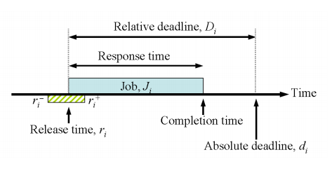
ضرب الاجل یا مهلت DEADLINES
• Completion time: the instant at which a job completes execution
• Relative deadline: the maximum allowable job response time
• Absolute deadline: the instant of time by which a job is required
to be completed (often called simply the deadline)
– absolute deadline = release time + relative deadline
– Feasible interval for a job Ji is the interval ( ri, di ]
• Deadlines are examples of timing constraints

Slide 10
مثال برای ضرب الاجل یا مهلت DEADLINES EXAMPLE
• A system to monitor and control a heating furnace:
• A system to monitor and control a heating furnace
• The system takes 20ms to initialize when turned on
• After initialization, every 100 ms, the system:
– Samples and reads the temperature sensor
– Computes the control-law for the furnace to process temperature readings,
determine the correct flow rates of fuel, air and coolant
– Adjusts flow rates to match computed values
• The periodic computations can be stated in terms of release times
of the jobs computing the control-law: J0, J1, …, Jk, …
– The release time of Jk is 20 + (k × 100) ms

Slide 11
مثال برای ضرب الاجل یا مهلت DEADLINES EXAMPLE
• A system to monitor and control a heating furnace:

Slide 12
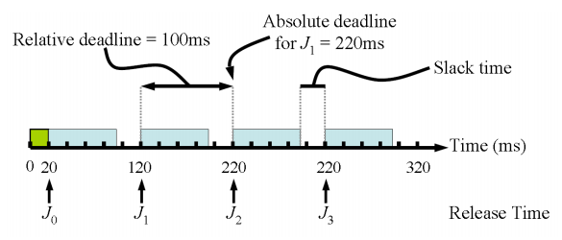
مثال برای ضرب الاجل یا مهلت DEADLINES EXAMPLE
• Alternatively, each control-law computation may be required to
finish sooner
- i.e. the relative deadline is smaller than the time between jobs, allowing some slack time for other jobs
– Slack time : the difference between the completion time and the earliest
possible completion time:

Slide 13
سیستم‌های بلادرنگ سخت Hard Real-Time Systems
The firmness of timing constraints affects how we reason about,
and engineer, the system
• hard real-time:
If a job must never miss its deadline
– A timing constraint is hard if the failure to meet it is considered a fatal error; this definition is based upon the functional criticality of a job
– A timing constraint is hard if the usefulness of the results falls off abruptly (or may even go negative) at the deadline
– A timing constraint is hard if the user requires validation
(formal proof or exhaustive simulation) that the system always
meets its timing constraint

Slide 14
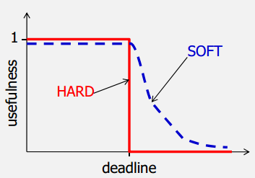
سیستم‌های بلادرنگ نرم Soft Real-Time Systems
• Soft real-time:
• If some deadlines can be missed occasionally,
with acceptably low probability
– This is a statistical constraint

Slide 15
سیستم‌های بلادرنگ سخت و نرم Hard Vs. Soft Real-Time Systems
• Note: there may be no advantage in completing a job early
– It is often better to keep jitter (variation in timing) in the response times of a stream of jobs small
• Timing constraints can be expressed in many ways:
– Deterministic
• e.g. the relative deadline of every control-law computation is 50 ms; the response time of at most 1 out of 5 consecutive control-law computations exceeds 50ms
– Probabilistic
• e.g. the probability of the response time exceeding 50 ms is less than 0.2
– In terms of some usefulness function
• e.g. the usefulness of every control-law computation is at least 0.8
[In practice, usually deterministic constraints, since easy to validate]

Slide 16
سیستم‌های بلادرنگ سخت و نرم Hard Vs. Soft Real-Time Systems
• Hard real-time:
– Flight control
– Railway signaling
– Anti-lock brakes
• Soft real-time:
– Stock trading system
– DVD player
– Mobile phone

Slide 17
مراجع
1- اين پاورپوينت از روی پاورپوينت مربوط به فصل 2 کتاب تهيه شده است
فصل 2 کتاب جین لیو
Real-Time Systems by Jane Liu, 2000.
Notes:
17

