Slide 1
سیستم های بلادرنگ Real Time Systems فصل اول - بعضی از کاربردهای بلادرنگ Typical Real-Time Applications قسمت دوم
دکتر محمد حسن شيرعلی شهرضا
دانشگاه صنعتی اميرکبير

Slide 2
Real-Time and Embedded Systems
• A real-time system is required to complete its work and deliver its services on a timely basis.
• Examples of real-time systems:
digital control,
command and control,
signal processing
telecommunication systems.

Slide 3
Real-Time and Embedded Systems
• Real-time system services:
When we drive,
they control the engine and brakes of our car and regulate trafﬁc lights.
When we ﬂy,
they schedule and monitor the takeoff and landing of our plane, make it ﬂy, maintain its ﬂight path, and keep it out of harm’s way.
When we are sick,
they may monitor and regulate our blood pressure and heart beats.
When we are well,
they can entertain us with electronic games and joy rides.
Unlike PCs and workstations that run nonreal-time applications such as our editor and network browser,
the computers and networks that run real-time applications
are often hidden from our view.
When real-time systems work correctly and well,
they make us forget their existence.

Slide 4
Command and Control systems
• The controller at the highest level of a control hierarchy is
a command and control system.
• An Air Traffic Control (ATC) system is an excellent example.
• The ATC system monitors the aircraft in its coverage area and the environment,
• Outputs from the ATC system include the assigned arrival
Times
• ATC system provides voice and telemetry links to on-board avionics

Slide 5
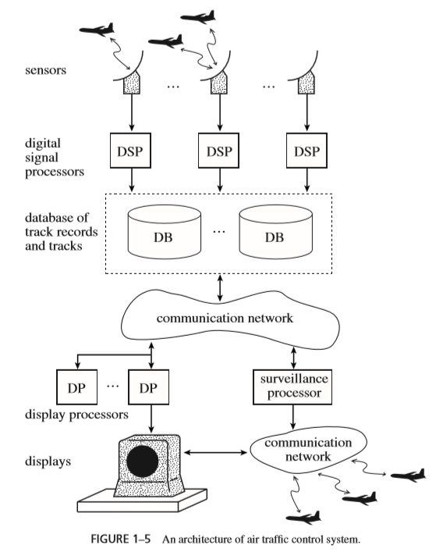
Air Traffic Control System

Slide 6
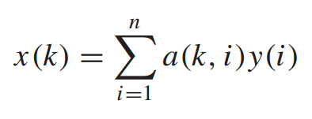
Real-Time Signal Processing
• a real-time signal processing application
computes in each sampling period one or more outputs
• Each output x(k) is a weighted sum of n inputs y(i)’s.
• In the simplest case, the weights, a(k, i)’s, are known and fixed.
• Different sets of weights, a(k, i)’s, give different kinds of transforms.
• e.g., a voice, an image or a radar signal

Slide 7
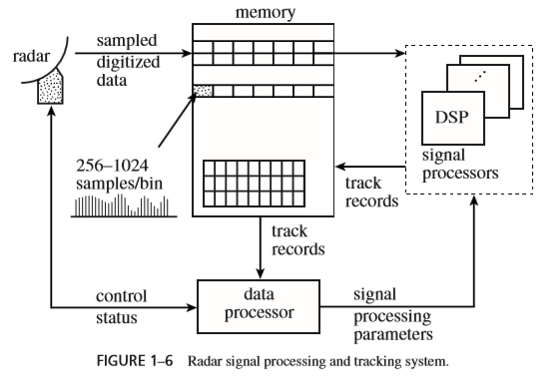
Radar System

Slide 8
Radar System
• Radar sends a short radio frequency pulse.
It then collects and examines the echo signal returning to the antenna.
• The echo signal reﬂected by the object at distance x,
returns to the antenna at approximately 2x/c seconds after the transmitted pulse, where c =3×10⁸ meters per second is the speed of light.
• If the object is moving, the frequency of the reﬂected signal is
(called Doppler shift) is proportional to the velocity of the object.
• If there is an object, it generates a track record containing the position and velocity of the object and places the record in the shared memory.

Slide 9
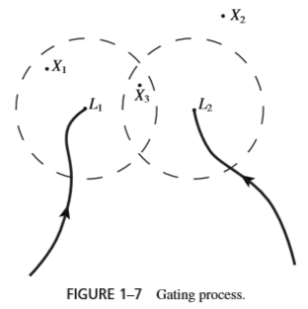
Radar System
• Tracking
An application that examines all the track records inorder to sort out false returns from real ones and update the trajectories of detected objects is called a tracker
Typically, tracking is carried out in two steps:
gating and data association
• Gating
Gating is the process of putting
each measured value into one of two
categories depending on whether
it can or cannot be tentatively
assigned to one or more
established trajectories.

Slide 10
Radar System
• Data Association.
The tracking process completes if, after gating, every measured value is assigned to at most one trajectory and every trajectory is assigned at most one measured value.
• There are many data association algorithms. One of the most intuitive is the the nearest neighbor algorithm.

Slide 11
Nearest Neighbor Algorithm
Examine the tentative assignments produced by the gating step.
For each trajectory that is tentatively assigned a single unique measured value, assign the measured value to the trajectory. Discard from further examination the trajectory and the measured value, together with all tentative assignments involving them.
For each measured value that is tentatively assigned to a single trajectory, discard the tentative assignments of those measured values that are tentatively assigned to this trajectory if the values are also assigned to some other trajectories.
2. Sort the remaining tentative assignments in order of non decreasing distance.
3. Assign the measured value given by the ﬁrst tentative assignment in the list to the corresponding trajectory and discard the measured value and trajectory.
4. Repeat step (3) until the list of tentative assignments is empty.
.

Slide 12
Real Time DataBases
What distinguish these databases from non real time databases is the perishable nature of the data maintained by them.
Speciﬁcally, a real-time database contains data objects,
called image objects, that represent real-world objects.
For example, an air trafﬁc control data base contains image objects that represent aircraft in the coverage area. The attributes of such an image object include the position and heading of the aircraft.
The values of these attributes are updated periodically based on the measured values of the actual position and heading provided by the radar system.
A non real-time databases (e.g., a payroll database) is that in the absence of updates, the data contained in them remain good.

Slide 13
Real Time DataBases
Absolute Temporal Consistency
A set of data objects is said to be absolutely (temporally) consistent if the maximum age of the objects in the set is no greater than a certain threshold.
Relative Temporal Consistency
A set of data objects is said to be relatively consistent if the maximum difference in ages of the objects in the set is no greater than the relative consistency threshold used by the application.

Slide 14
Multimedia Applications
A multimedia application may process, store, transmit, and display any number of video streams, audio streams, images, graphics, and text.
A video stream
is a sequence of data frames which encodes a video.
Without compression, the storage space and transmission bandwidth required by a video are enormous.
An audio stream
encodes a voice, sound, or music.

Slide 15
MPEG Compression/Decompression
A video compression standard is MPEG-2
The standard makes use of three techniques:
Motion Estimation
for reducing temporal redundancy,
Discrete Cosine Transform and Encoding
for reducing spatial redundancy
Entropy Encoding
for reducing the number of bits required to encode all the information.
Depending on the application, the compressed bit rate ranges from 1.5 Mbits/sec to 35 Mbits/sec.

Slide 16
مراجع
1- اين پاورپوينت از فصل 1 کتاب تهيه شده است
فصل 1 کتاب جین لیو
Real-Time Systems by Jane Liu, 2000.
Notes:
16

