Slide 1
سیستم های بلادرنگ Real Time Systems فصل اول - بعضی از کاربردهای بلادرنگ Typical Real-Time Applications قسمت اول
دکتر محمد حسن شيرعلی شهرضا
دانشگاه صنعتی اميرکبير

Slide 2
معرفی درس
فهرست مطالب درس:
• Introduction to Real-Time and Embedded Systems (Ch. 1)
– Hard versus soft real-time (Ch. 2)
– Reference Model (Ch. 3)
•Job Scheduling (Ch. 4)
– Clock driven scheduling algorithms (Ch. 5)
– Priority driven scheduling algorithms (Ch. 6)
–Scheduling Aperiodic and Sporadic Jobs in Priority-Driven Systems (Ch. 7)
• Resources and Resource Access Control (Ch. 8)
•Operating Systems (Ch. 12)

Slide 3
Real-Time and Embedded Systems
•A real-time system must deliver services in a timely manner
–Not necessarily fast, but must meet some timing deadline
•An embedded system is hidden from view within a larger system
•Many real-time and embedded systems exist, often without the awareness of their users
–Washing machine, photocopier, mobile phone, car, aircraft, industrial plant, microwave oven, toothbrush, CD player, medical devices, etc.
•Must be able to validate real-time systems for correctness
–Some embedded real-time systems are safety critical
–i.e. if they do not complete on a timely basis, serious consequences result
–Bugs in embedded real-time systems are often difficult or expensive to fix

Slide 4
Real-Time and Embedded Systems
•This module will discuss several representative classes of real time and embedded system:
– Digital process control
– Higher-level command and control
– Tracking and signal processing
– Real-time databases
– Telephony and multimedia
•Algorithms for scheduling tasks such that those systems complete in a reliable and timely fashion
•Implementation techniques, operating systems and languages for building such systems

Slide 5
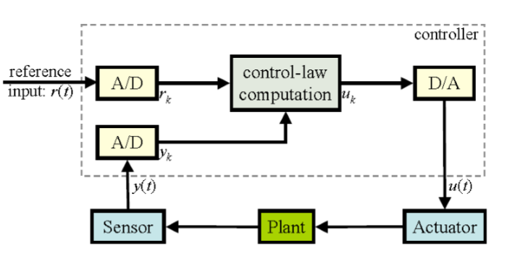
Digital Process Control
•Controlling some device (the “plant”) using an actuator, based on sampled sensor data
– y(t) is the measured state of the plant
– r(t) is the desired state of the plant
– Calculate control output u(t)as a function of y(t) and r(t),
or e(t) = r(t) - y(t).

Slide 6
Digital Process Control
•Pseudo-code for the controller as an infinite timed loop:
set timer to interrupt periodically with period T;
at each timer interrupt, do
do analogue-to-digital conversion of y(t)to get yk;
compute control output uk based on reference rk and yk;
do digital-to-analogue conversion of uk to get u(t);
end do;

Slide 7
Digital Process Control
•Effective control of the plant depends on:
–The correct control law computation and reference input
– The accuracy of the sensor measurements:
•Resolution of the sampled data (i.e. bits per sample)
•Timing of the clock interrupts (i.e. samples per second, 1/T)

Slide 8
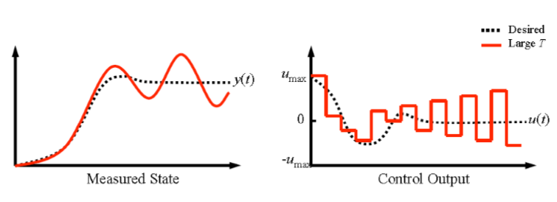
Digital Process Control
•The time T between any two consecutive measurement of y(t) and r(t) is the sampling period
– Small T better approximates the analogue behavior
– Large T means less processor-time demands
Must achieve a compromise
•If T is too large, oscillation will result as the system tries to adapt

Slide 9
Digital Process Control
•How to choose sampling period?
–Rise time
–the amount of time that the plant takes to reach some small neighborhood around the final state in response to a step change in the reference input
– If R is the rise time, and T is the period, a good rule of thumb is that the ratio 10 ≤ R/T ≤ 20
•Must be chosen correctly, and accurately implemented to ensure stability
•Multi-rate systems –system is composed of multiple sensors and actuators, each of which require different sampling periods
– Need to run multiple control loops at once, accurately
– Usually best to have the sampling periods for the different degrees of freedom related in a harmonic way

Slide 10
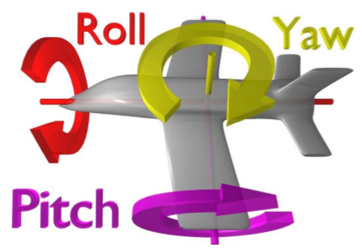
Example: Helicopter Flight Control
• Do the following in each 1/180-second cycle:
•Validate sensor data and select data source;
on failure reconfigure the system
•Do the following 30-Hz avionics tasks, each once every 6 cycles:
– Keyboard input and mode selection
– Data normalization and coordinate transformation
– Tracking reference update
•Do the following 30-Hz computations, each once every 6 cycles
–Control laws of the outer pitch-control loop
–Control laws of the outer roll-control loop
–Control laws of the outer yaw
and collective-control loop

Slide 11
Example: Helicopter Flight Control
•Do each of the following 90-Hz computations once every 2 cycles, using outputs produced by the 30-Hz computations
– Control laws of the inner pitch-control loop
– Control laws of the inner roll-and collective-control loop
•Compute the control laws of the inner yaw-control loop, using outputs from the 90-Hz computations
•Output commands to control surfaces
•Carry out built-in-test

Slide 12
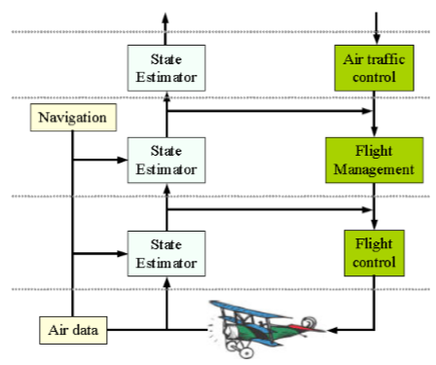
Higher-Level Control
•Controllers often organized in a hierarchy
–Multiple control loops, higher level controllers monitoring the behavior of low level controllers
–Time-scale, complexity of decision making, increases as go up hierarchy; Move from control to planning
–Higher level planning must still
be done in real-time,
although deadlines are less tight

Slide 13
Real-Time Communications
•Real-time systems are increasingly distributed, including communication networks
–Control loop may include a communication step
–System may depend on network stimuli
•Not only does a system need to run a control law with time constraints, it must also schedule communications, sending and receiving messages according to deadlines

Slide 14
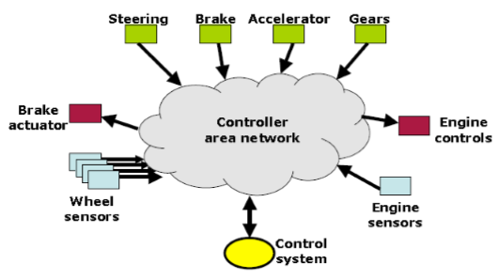
Example: Drive by Wire
•All data must be delivered reliably
–Bad if you turn the steering wheel, and nothing happens
•Commands from control system have highest priority, then sensors and actuators, then control inputs
–Antilock brakes have a faster response time than the driver, so prioritise to ensure the car doesn’t skid
•Network must schedule and prioritise communications

Slide 15
Example: Packet Voice
•Voice is digitized and sent as a sequence of packets
–Constant spacing, every 10-30ms depending on codec
•Strict timeliness requirement
–Mouth to ear delay needs to be less than approximately 150ms
–Packets must be played out with equal spacing
•Relaxed reliability requirement
–Some small fraction of packets can be lost, and just sound like crackles on the wire; most need to arrive
•Emergency calls may have priority

Slide 16
Types of Real-Time Application
•Purely cyclic
–Every task executes periodically
–Demands in (computing, communication, and storage) resources do not vary significantly from period to period
– Example: most digital controllers and real-time monitors
•Mostly cyclic
–Most tasks execute periodically
–The system must also respond to some external events (fault recovery and external commands) asynchronously
–Example: modern avionics and process control system

Slide 17
Types of Real-Time Application
•Asynchronous: mostly predictable
–Most tasks are not periodic
–The time between consecutive executions of a task may vary considerably, or the variations in resource utilization in different periods may be larg
–These variations have either bounded ranges or known statistic
•Asynchronous: unpredictable
–Applications that react to asynchronous events and have tasks with high run-time complexity
–Example: intelligent real-time control systems

Slide 18
Implementation Considerations
•Some real-time embedded systems are complex, implemented on high-performance hardware
–Industrial plant control
–Civilian flight control
• Many must be implemented on hardware chosen to be low cost, low power, light-weight and robust; with performance a distant concern
– Military flight control, space craft control
– Consumer goods
•Often times implemented in C or assembler, fitting within a few kilobytes of memory
–Correctness a primary concern, efficiency a close second

Slide 19
مراجع
1- اين پاورپوينت از روی پاورپوينت مربوط به فصل 1 کتاب تهيه شده است
فصل 1 کتاب جین لیو
Real-Time Systems by Jane Liu, 2000.
Notes:
19

